Slide 1


BANGLADESH ARMY UNIVERSITY OF SCIENCE AND TECHNOLOGY
Book Recommender Using ML
Course Title: Machine Learning Sessional
Course Code: CSE 4140
Presented To: Presented By:
Engr. Rohul Amin Zihan Hossain
Lecturer, CSE, BAUST ID:220201067
Nadim Reza
Lecturer, CSE, BAUST

Slide 2
Outlines
Introduction
Objectives
Related Works
Dataset
Methodology
Models Used
Comparison Table
Conclusion
Reference

Slide 3
Introduction
The project aims to recommend books using machine learning to provide personalized reading suggestions for user.
The project also aims to improve recommendation accuracy by continuously learning from new data and refining the model.

Slide 4
Objectives
To recommendation book using machine learning
To analyze user data and identify reading patterns.
To apply ML algorithms for book recommendation.
To improve recommendation accuracy.

Slide 5
Related works
In 2020, SlideShare developed a “Book Recommendation System using machine learning”
Shortcomings:
Basic preprocessing only
Small Dataset

Slide 6
Related Works (Cont.)
In 2024, ResearchGate developed a “Book Recommendation using machine learning techniques”
Shortcomings:
Small dataset size
Overfitting not discussed

Slide 7
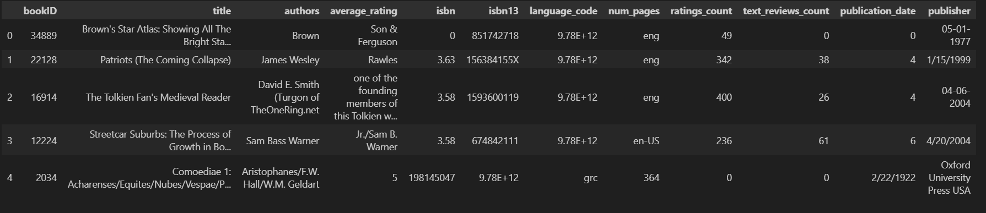
Dataset

Slide 8
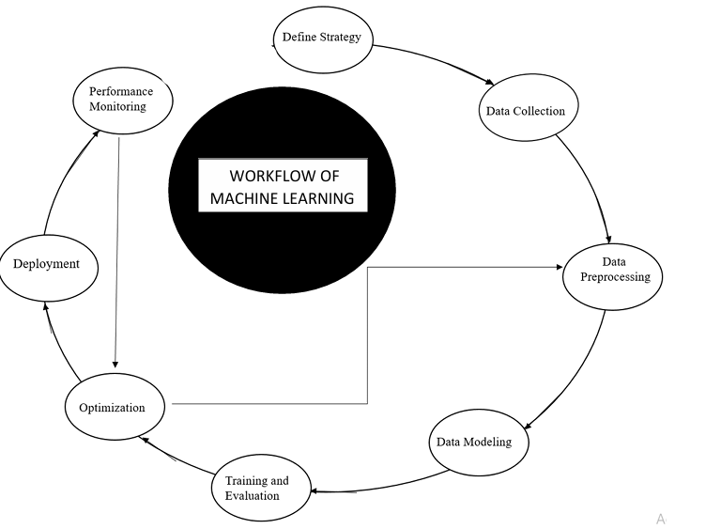
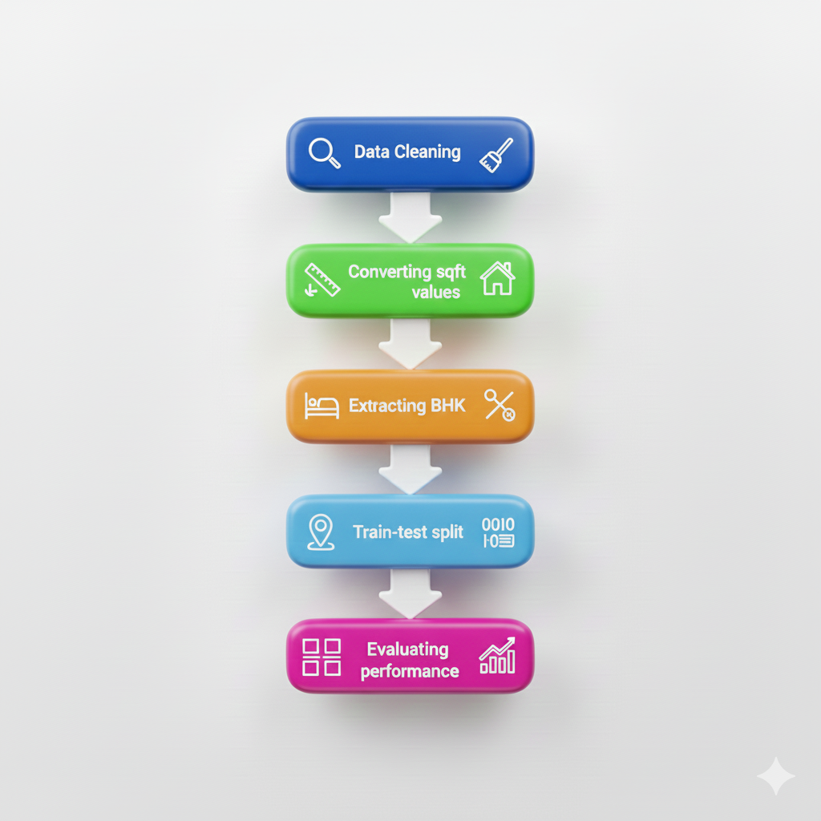
Methodology

Slide 9
Model Used
Linear Regression.
Lasso Regression.
Decision Tree .
Random Forest.

Slide 10
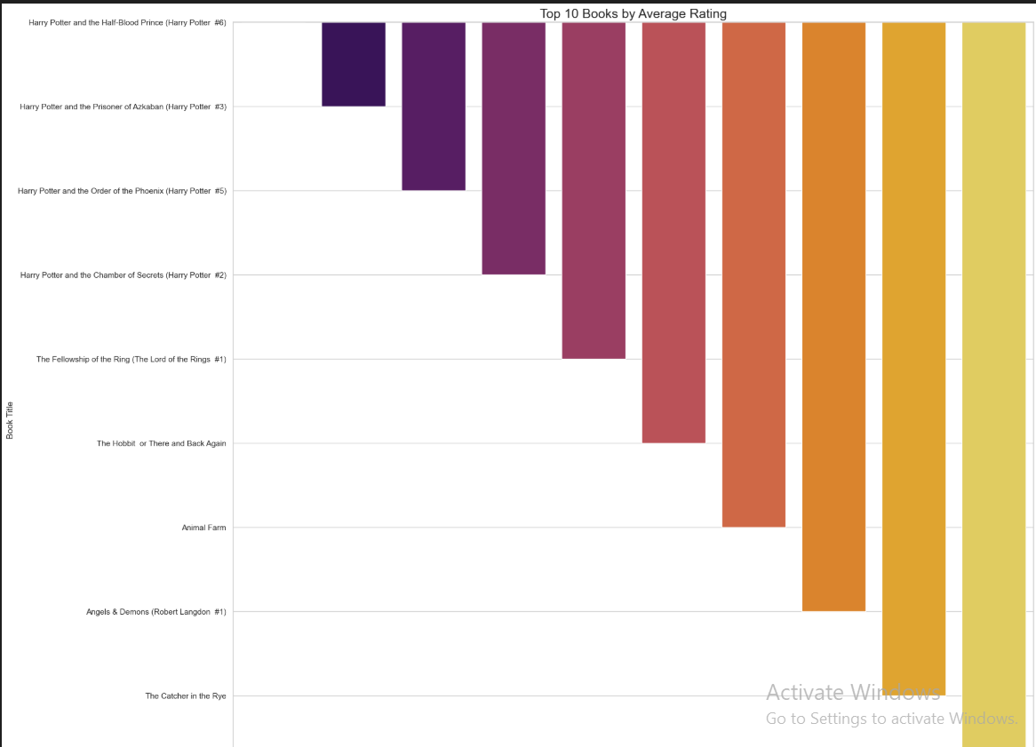
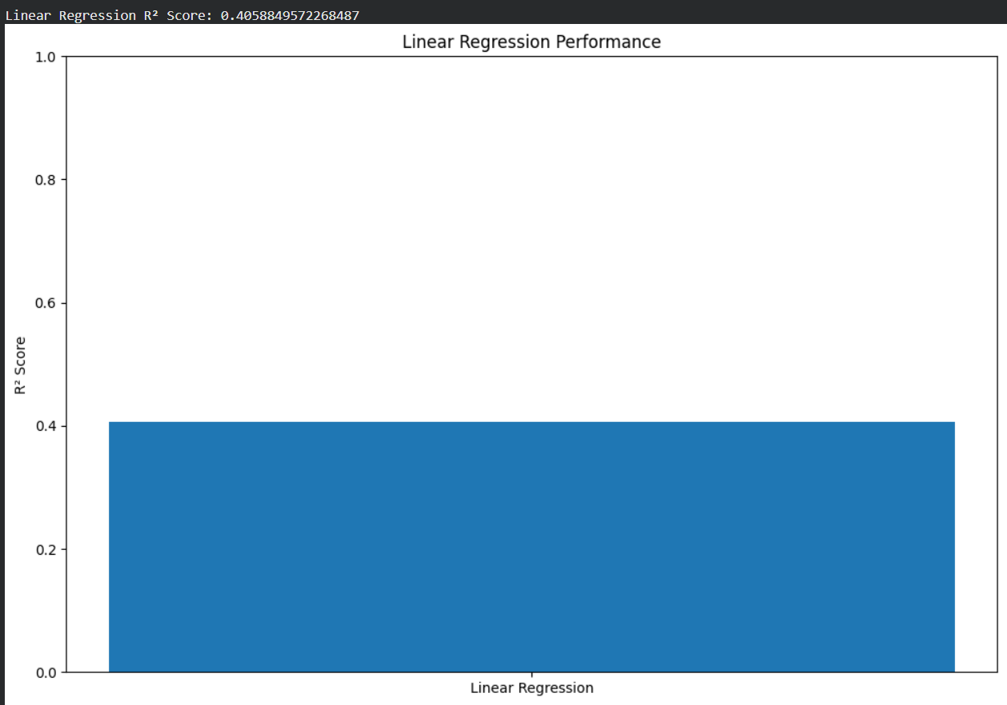
Model Used (Cont.)

Slide 11
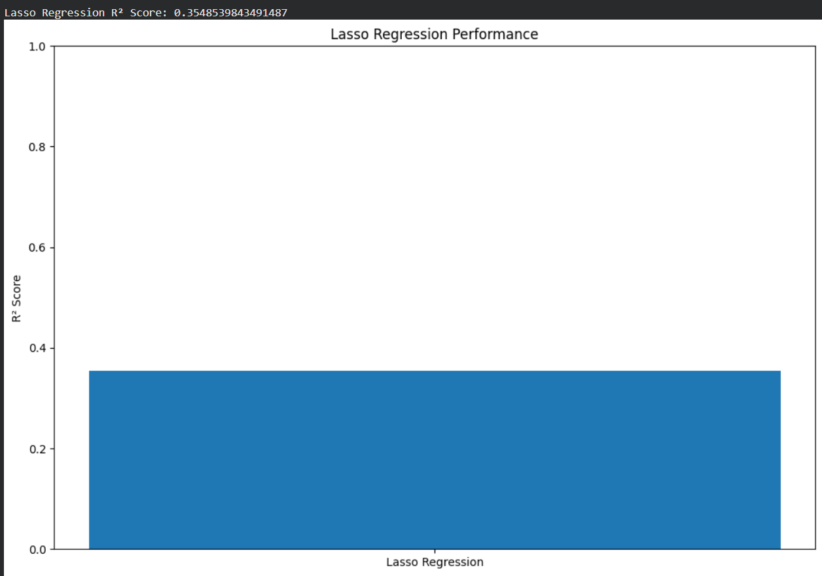
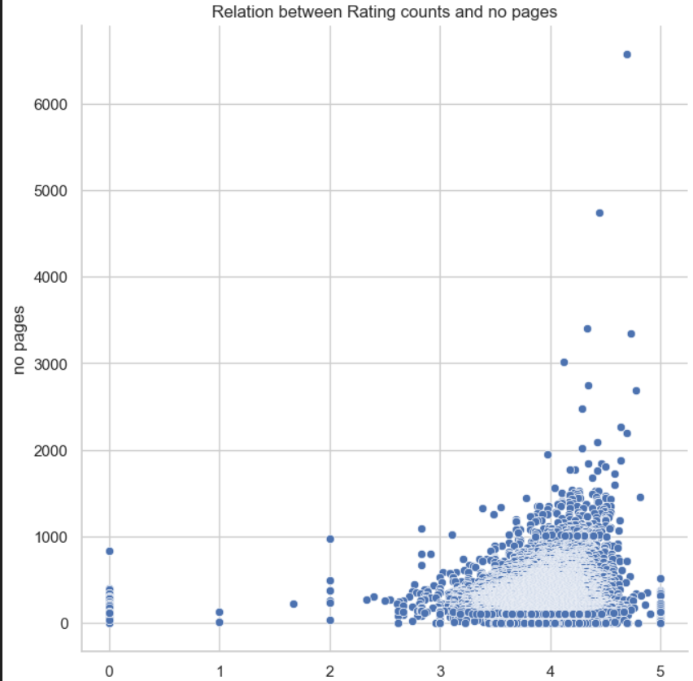
Model Used(Cont.)

Slide 12
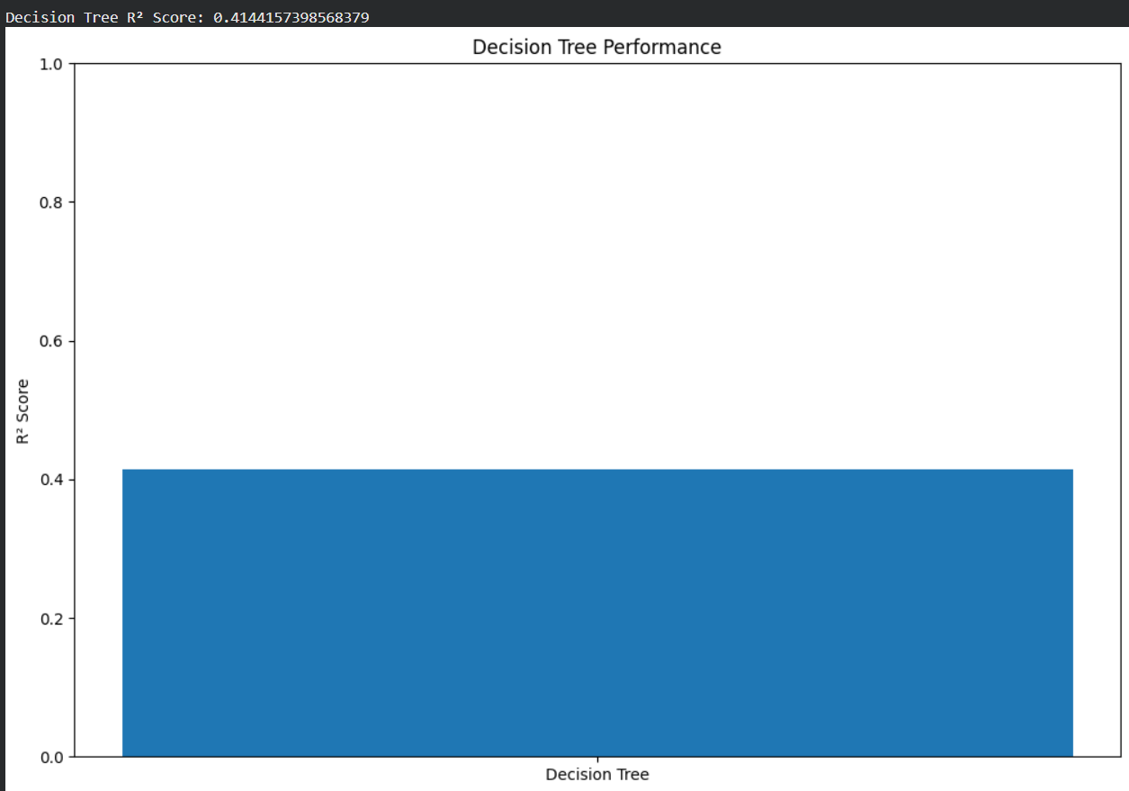
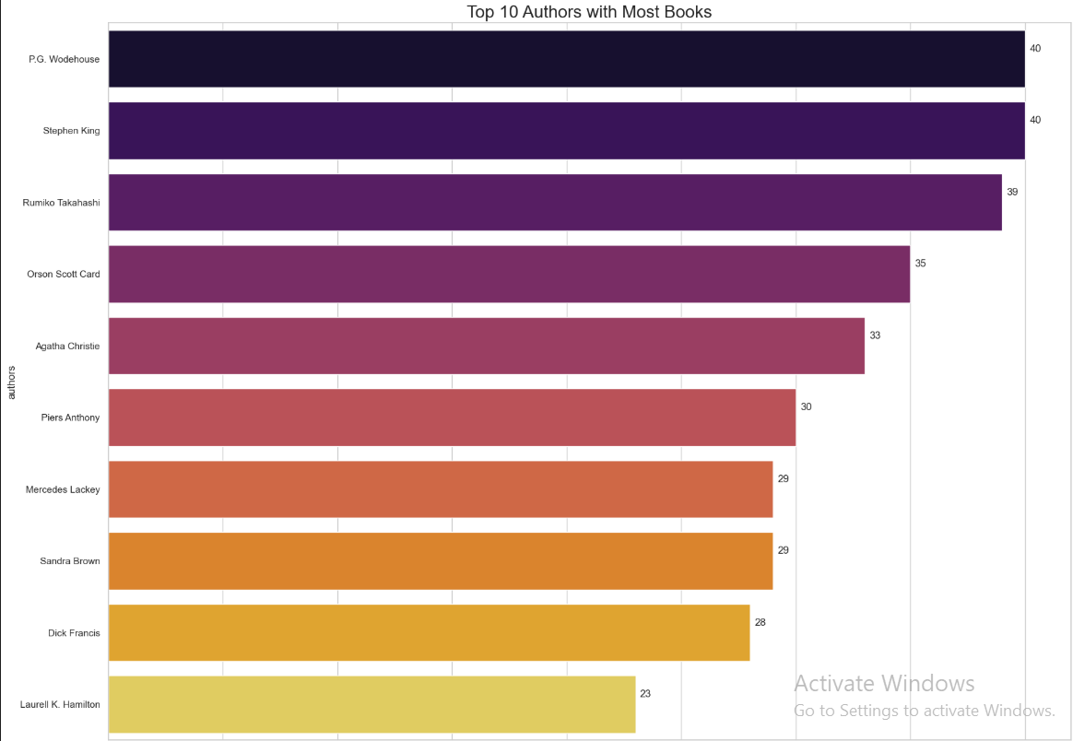
Model Used(Cont.)

Slide 13
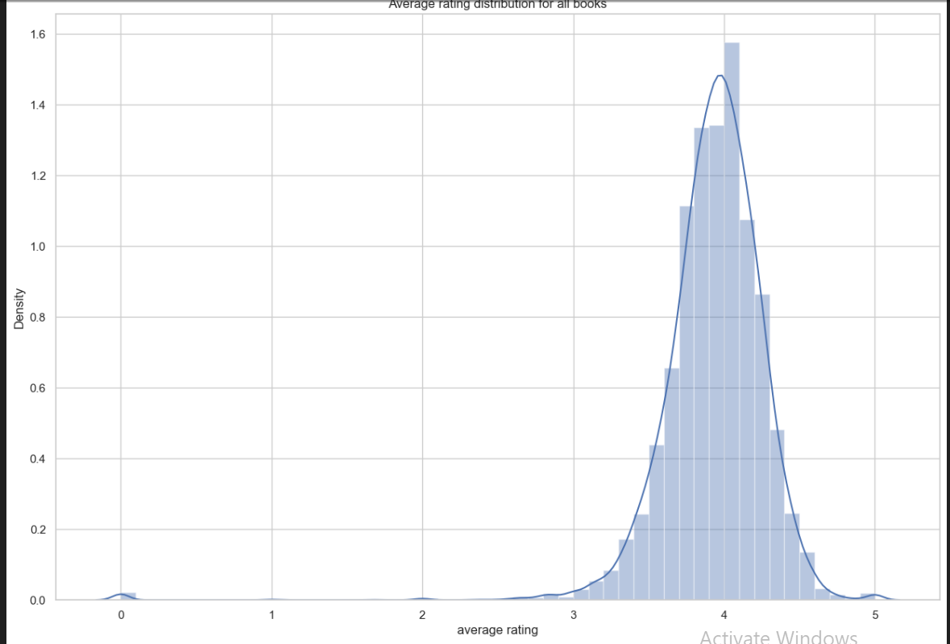
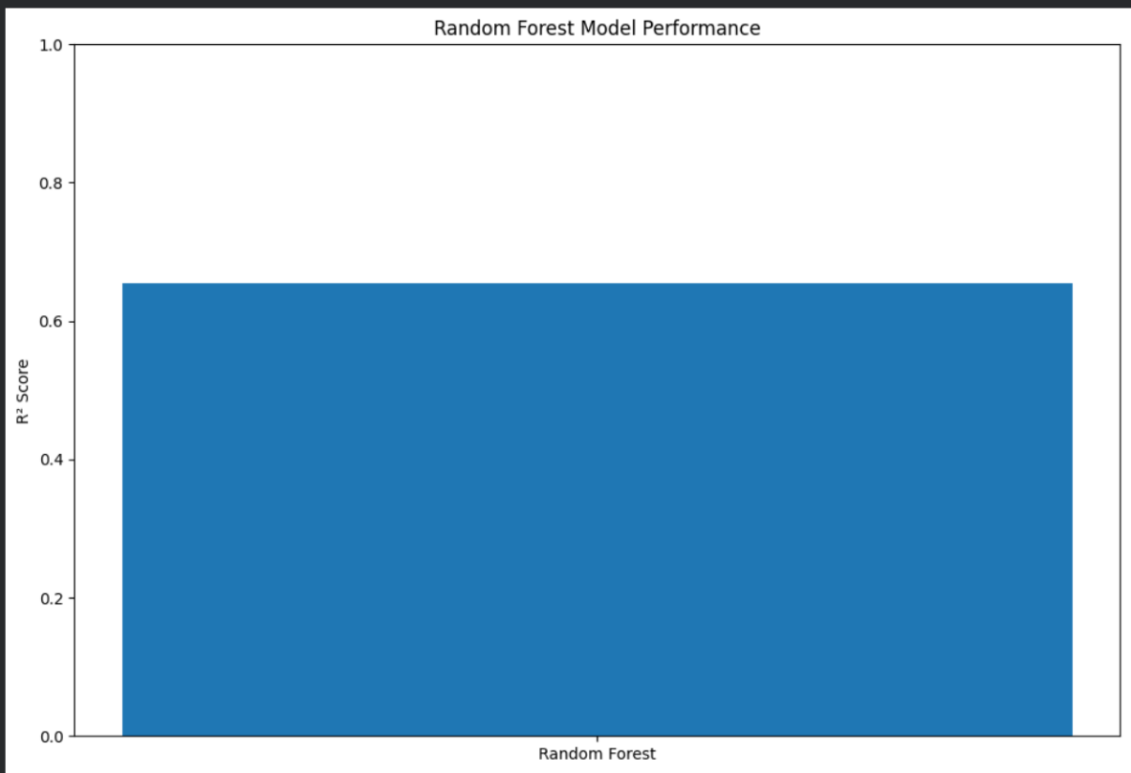
Model Used(Cont.)

Slide 14
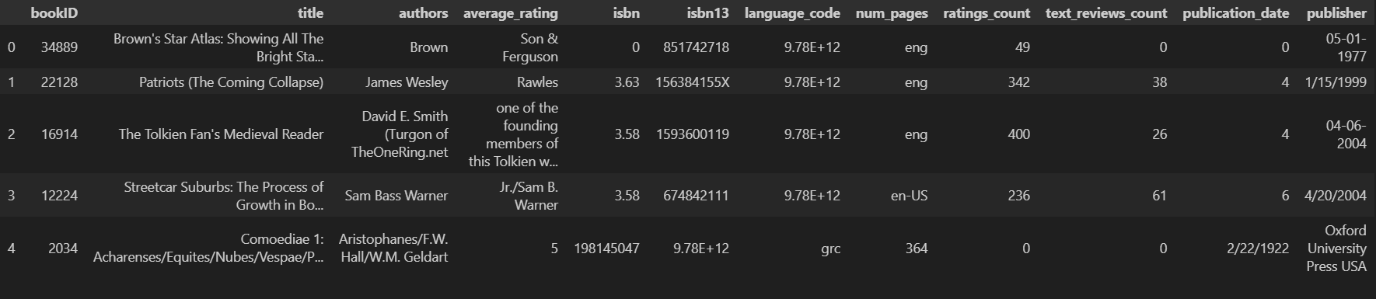
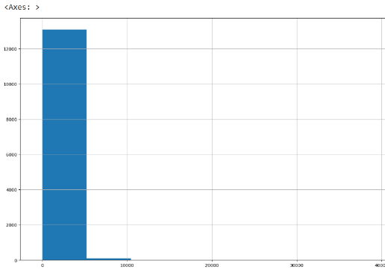
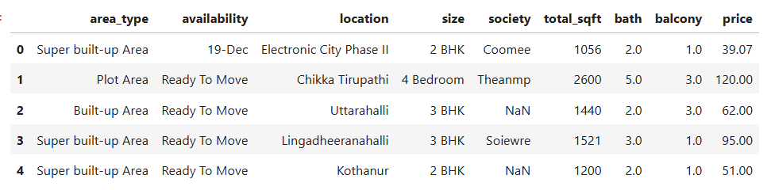
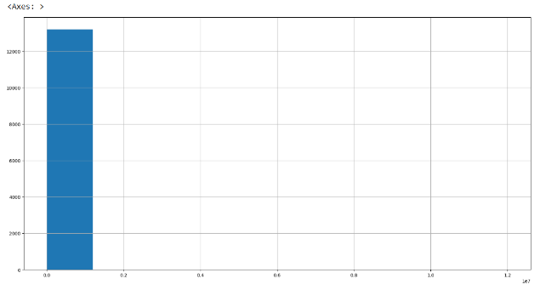
Model Used(Cont.)
Fig:Dataset
Fig.Relation between rating count
Fig:Top 10 Authors with most book
Fig:Average Rating
Fig:BHK Distributions

Slide 15
Comparison Table
Model | Accuracy (0–1) | Accuracy (%)
Linear Regression | 0.8067 | 80.67%
Lasso Regression | 0.6287 | 62.87%
Decision Tree | 0.8168 | 81.68%
Random Forest | 0.6–0.80 (approx) | 60–80%

Slide 16
Conclusion
Cleaning and removing outliers improved accuracy a lot.
This system can help in real-estate decision making.

Slide 17
Thank You

